Slide 1

Actuarial Analyst
By Mohammad Hossein Movahedi
Module 4 Project — Roles within Data Analytics Presentation

Slide 2


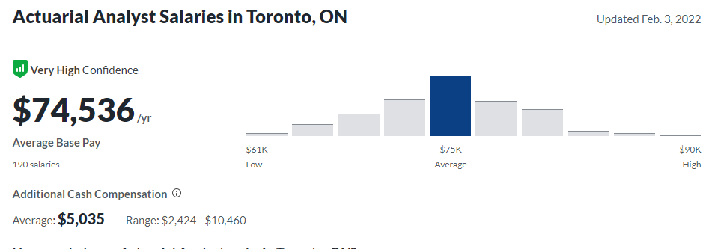
Actuarial Analyst Identity
Types of actuarial analyst (finance, general insurance, life assurance,etc …)(Prospects.ac.uk, 2020)
Responsibilities (advanced statistics and modelling, data analysis, write reports,etc…) (Prospects.ac.uk, 2020)
Salary (Glassdoor, 2021)
Notes:
As an actuarial analyst, you'll use statistical formulas to assess risk. In life insurance, for example, this could involve working out the average life expectancy of different demographics to determine the policy premiums each should be charged.
Analysts use specialist computational software and spreadsheets, so an interest in and aptitude for using IT is useful. You could work in various areas of the financial services industry and will often be engaged in a support role within an actuarial team.

Slide 3
importance of being actuarial analyst
An actuary is a professional that uses statistics to predict the likelihood of certain events occurring in the future.
They’re able to use math and statistics on large amounts of data in order to predict the timing and financial impact of uncertain future events.
You may not know what’s fair, but an actuary would know(Brea, 2018)

Slide 4

actuarial analyst : The Professional
In the U.S. and Canada, you have to be a member of the Society of Actuaries or the Casualty Actuarial Society to be considered an actuary. There are several requirements that need to be met in order to do this though.
the actuarial exams are a series of 10 exams with multiple choice and written answer type questions. The exams are timed for 3 to 5 hours depending on the exam and the series takes most people between 7 and 10 years to complete.

Slide 5
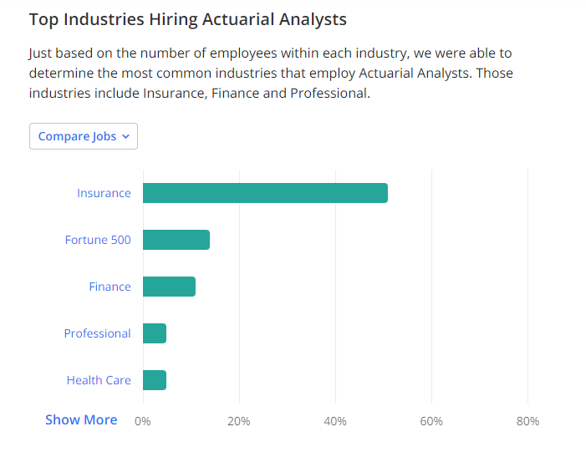
The Usual industries
Actuaries can work in a variety of different settings. Most notoriously though, they’re working in insurance companies.
Insurance is a risky business, so having the analytical skills of actuaries is incredibly important.

Slide 6
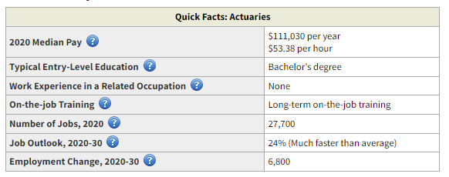
Back to the Future of actuaries
U.S. BUREAU OF LABOR STATISTICS

Slide 7

References
Prospects.ac.uk. (2020). Actuarial analyst job profile | Prospects.ac.uk. [online] Available at: https://www.prospects.ac.uk/job-profiles/actuarial-analyst [Accessed 12 Feb. 2022].
‌Glassdoor. (2021). Salary: Actuarial Analyst in Toronto, ON. [online] Available at: https://www.glassdoor.ca/Salaries/toronto-actuarial-analyst-salary-SRCH_IL.0,7_IM976_KO8,25.htm?clickSource=searchBtn [Accessed 12 Feb. 2022].
‌Brea (2018). What is an actuary? Details for anyone considering the career. - Etched Actuarial. [online] Etched Actuarial. Available at: https://etchedactuarial.com/what-is-actuary/ [Accessed 12 Feb. 2022].
‌Bls.gov. (2022). Actuaries : Occupational Outlook Handbook: : U.S. Bureau of Labor Statistics. [online] Available at: https://www.bls.gov/ooh/math/actuaries.htm [Accessed 12 Feb. 2022].
‌Soa.org. (2022). MEMBER | SOA. [online] Available at: https://www.soa.org/ [Accessed 12 Feb. 2022].
‌Zippia.com. (2021). Actuarial Analyst Demographics and Statistics [2022]: Number Of Actuarial Analysts In The US. [online] Available at: https://www.zippia.com/actuarial-analyst-jobs/demographics/ [Accessed 12 Feb. 2022].

